Slide 1

Air Pollution Visualization System
Reporters ：许文杰，陆仟龙，赵睿睿
PM : 许文杰 202230310220
Team members：赵睿睿 202230310197
陆仟龙 202230310293

Slide 2

Catalog
1. Final Product Demo
2. Project Execution Detail
3. Risk Plan
4. Test Plan & Test Cases
5. Lessons Learnt
6. Conclusion
7. Future Plan For Next Cycle
1
2
3
4
5
6
7

Slide 3
01
Final Product Demo

Slide 4
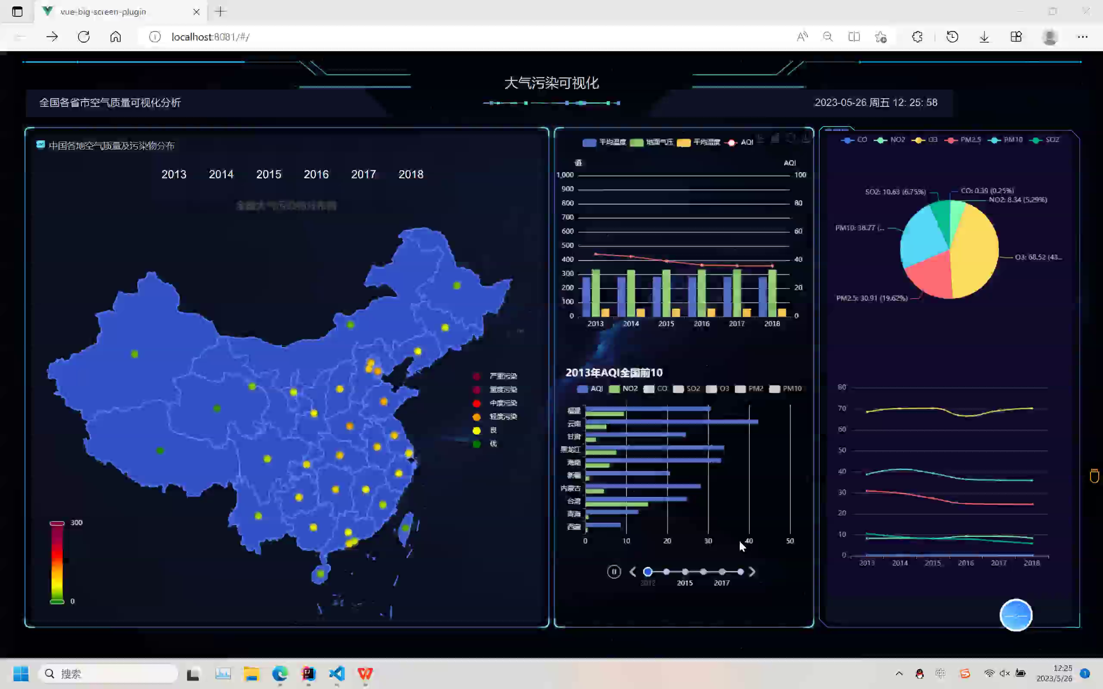
Demo
Project Background
Home
page

Slide 5
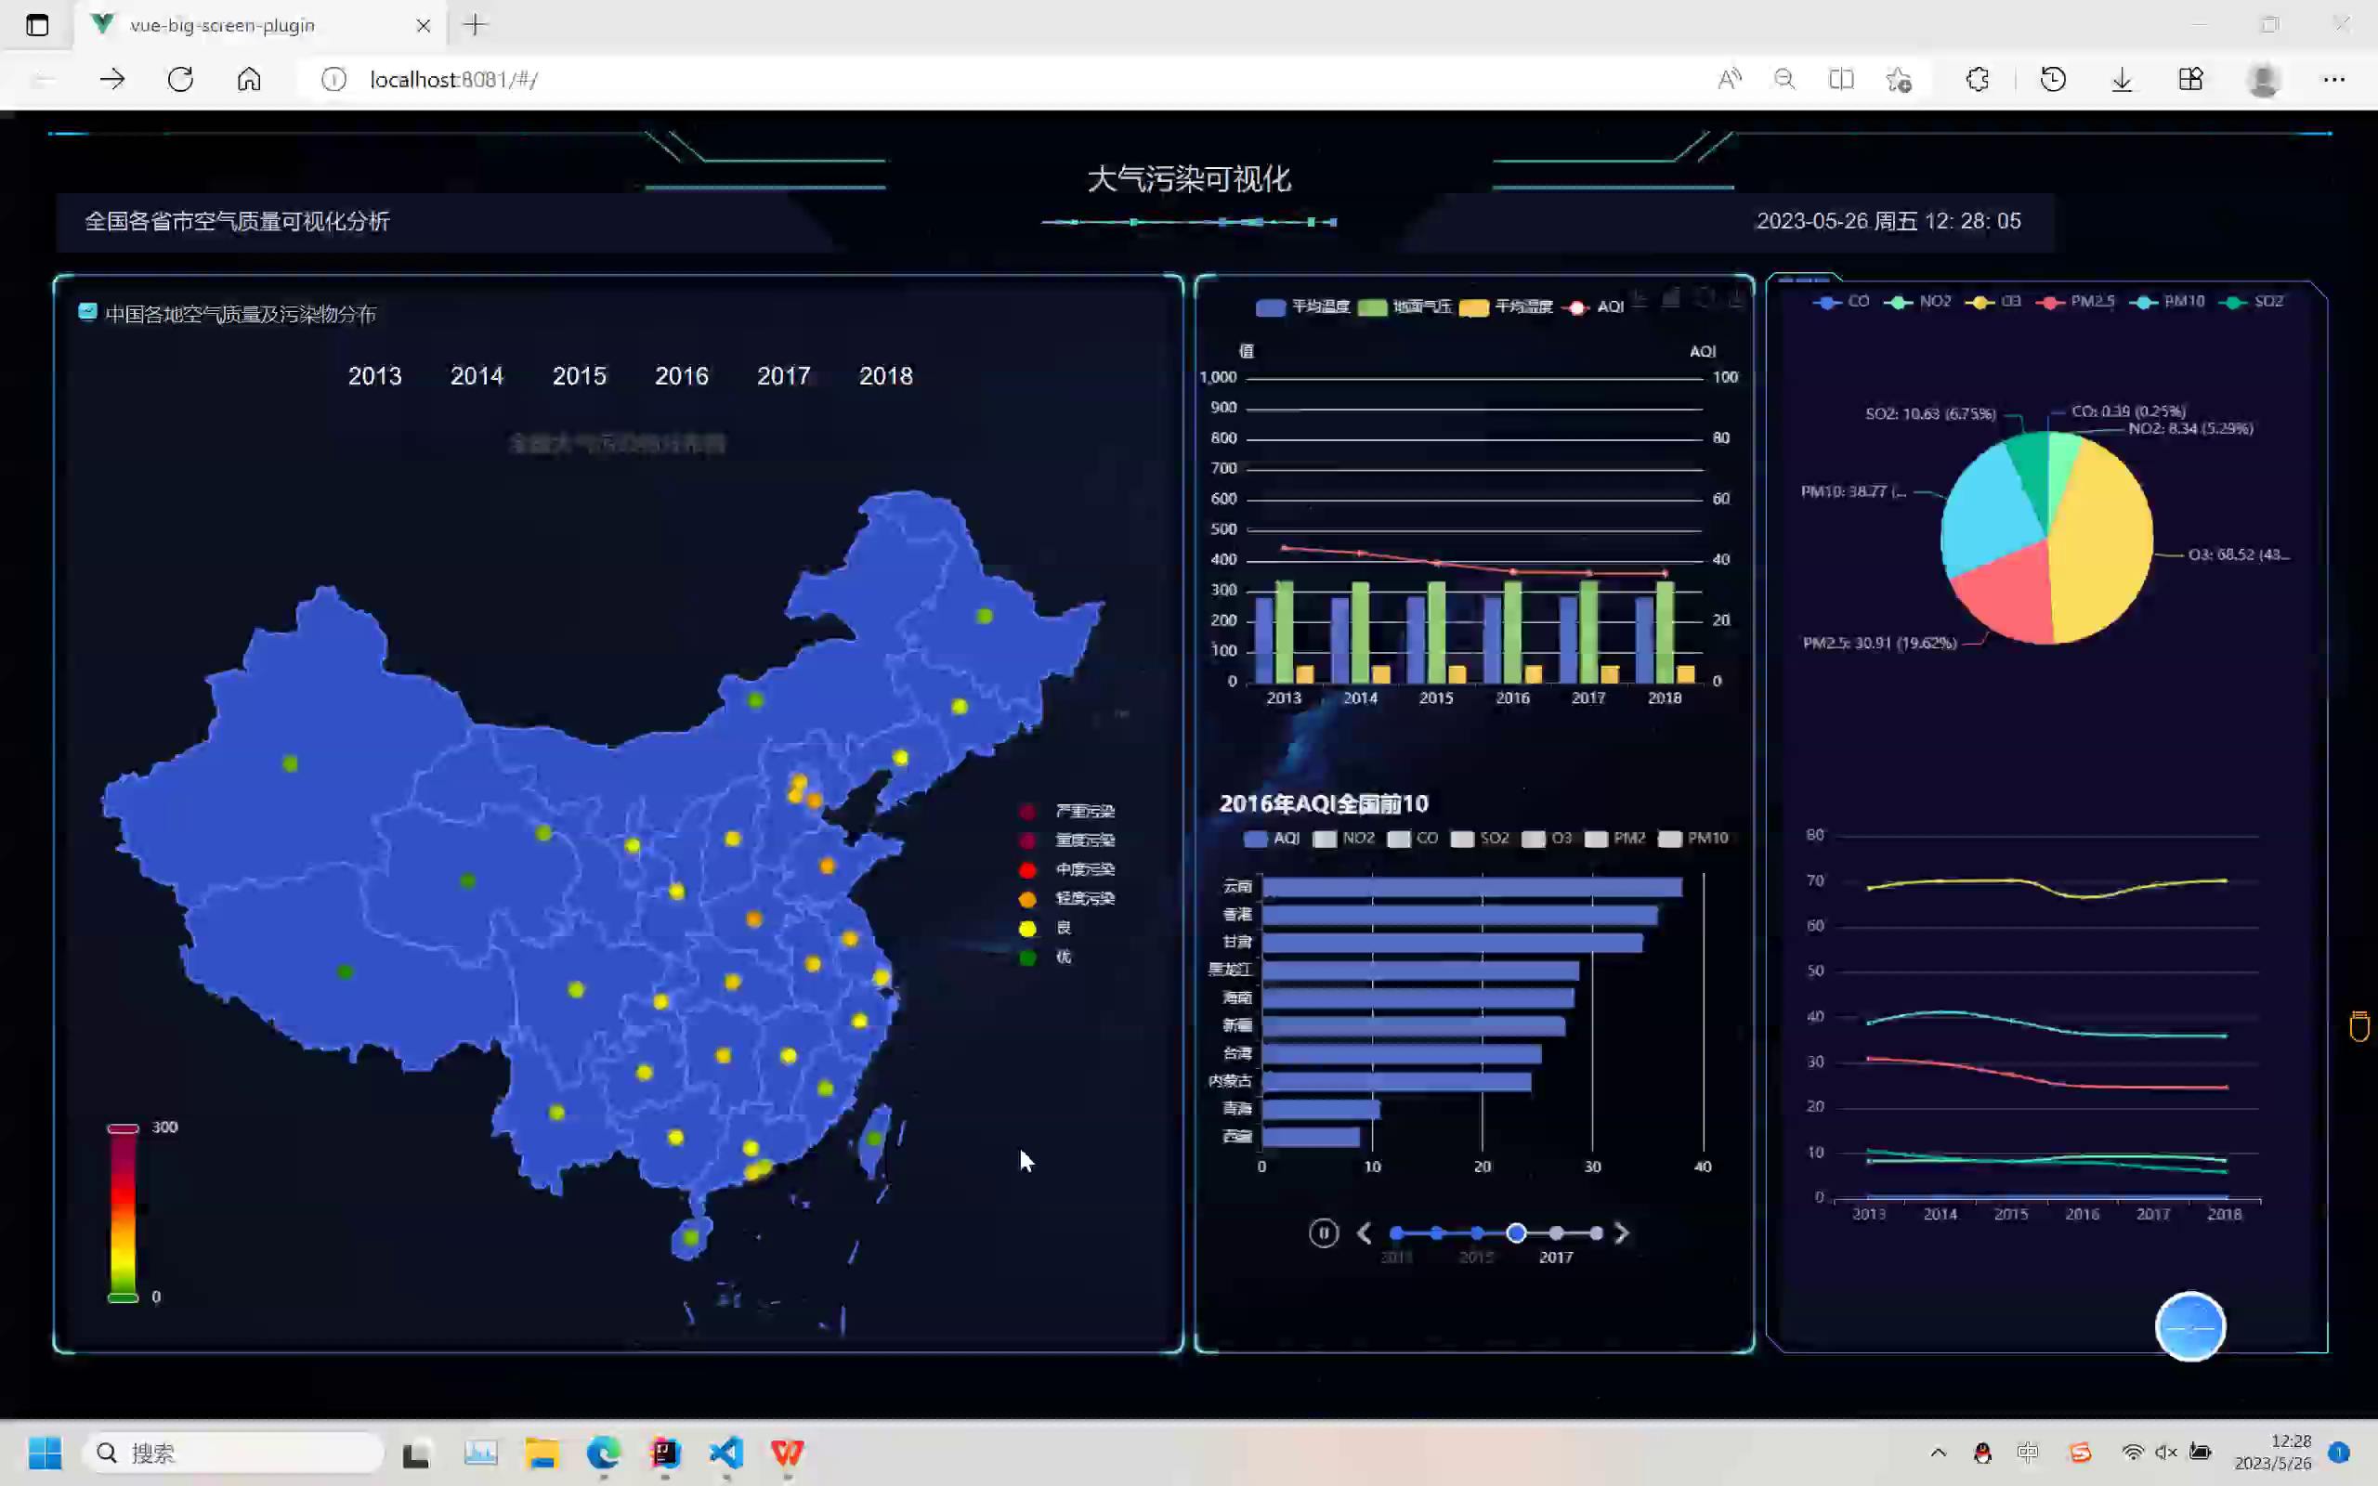
Demo
Project Background
Click
Event

Slide 6
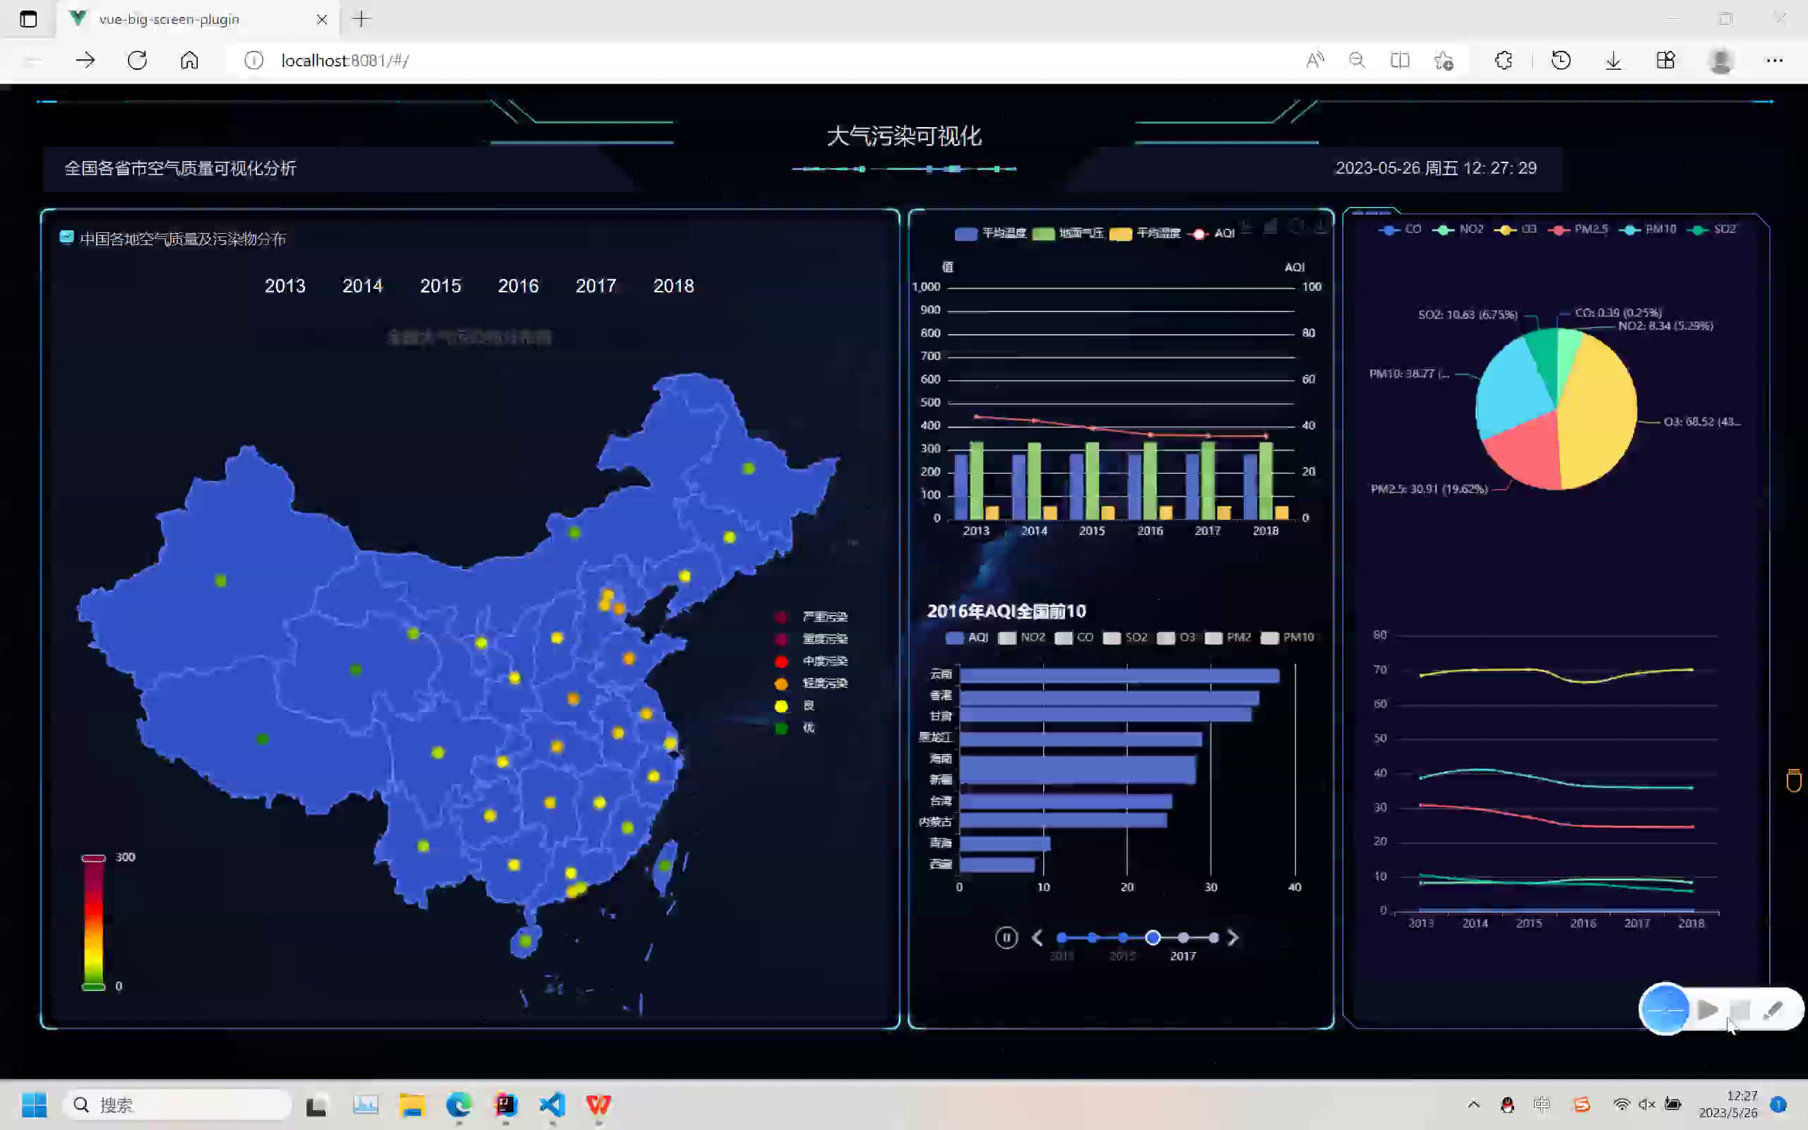
Project Intro
Project Background
Map Down Drilling

Slide 7
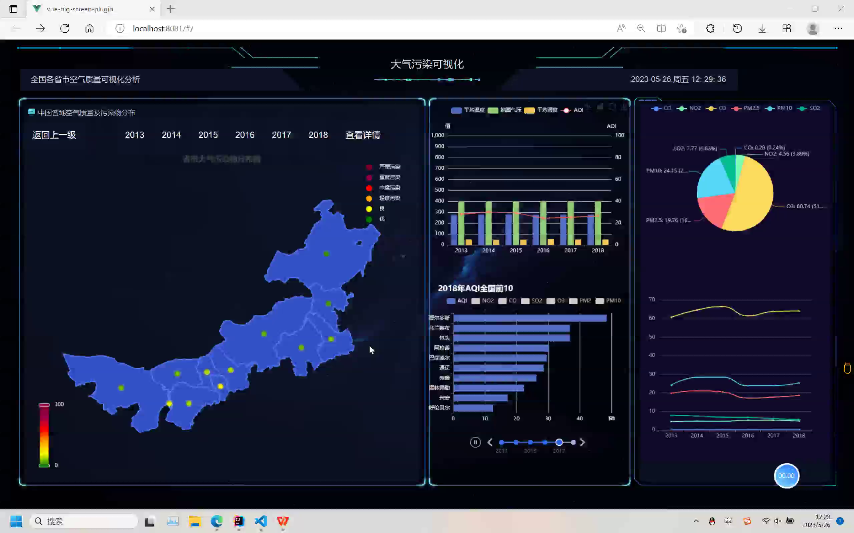
Project Intro
Project Background
Detail

Slide 8
Project
Execution Detail
02

Slide 9
Execution Detail
Project Progress

Slide 10
Execution Detail
Design
Project Progress
max varience(20%)

Slide 11
Execution Detail
Design
Time Cost

Slide 12
Execution Detail
Design
Time Cost
negative
variance

Slide 13
Risk Plan
03

Slide 14
Risk level | Predicted risks | Solution | Did we encounter
Low-level risk | Due to need to learn other subjects, some tasks cannot be completed as expected…… | Select other times to catch up the progress. | √
 |  |  | √
 | During May Day, everyone was resting……
 |  |  | √
 | If someone leave of absence, the progress was delayed……
 |  |  | ×
 | If someone gets sick, and can recover in the short term……
Middle-level risk | If someone gets sick, and need to takes a long time to recover…… | the only way to do so is to increase the workload of other members or to find new members. | ×
High-level risk | If the current plan is not feasible, or is not recognized by Party A (teacher) | Change the project plan. | ×
 | If loss of the important data…… | Make backups in advance. | ×

Slide 15
Test Plan
&
Test Cases
04

Slide 16
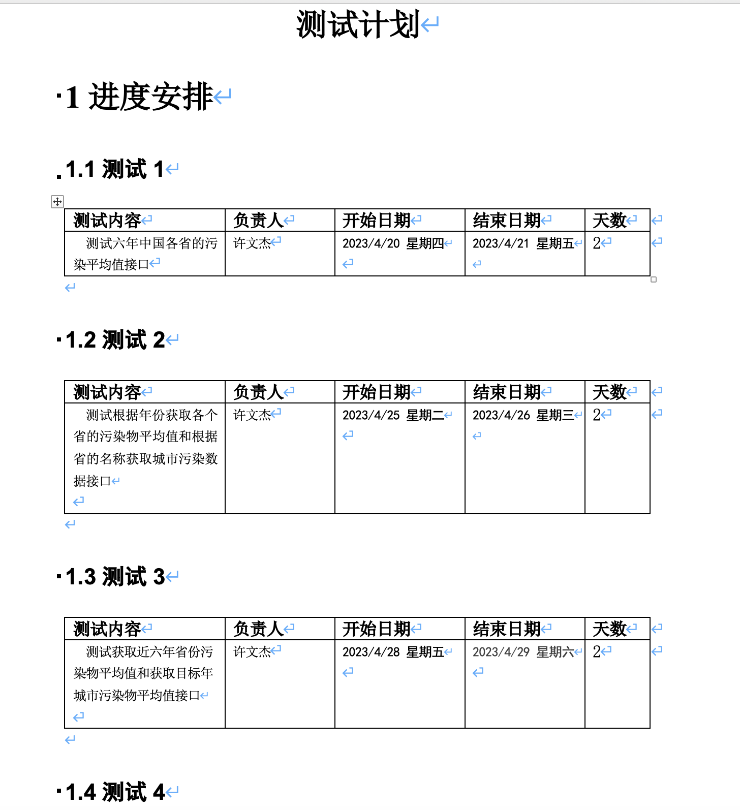
Test Plan
Schedule
Test content
Responsible person
Start Date
End Date
Duration

Slide 17
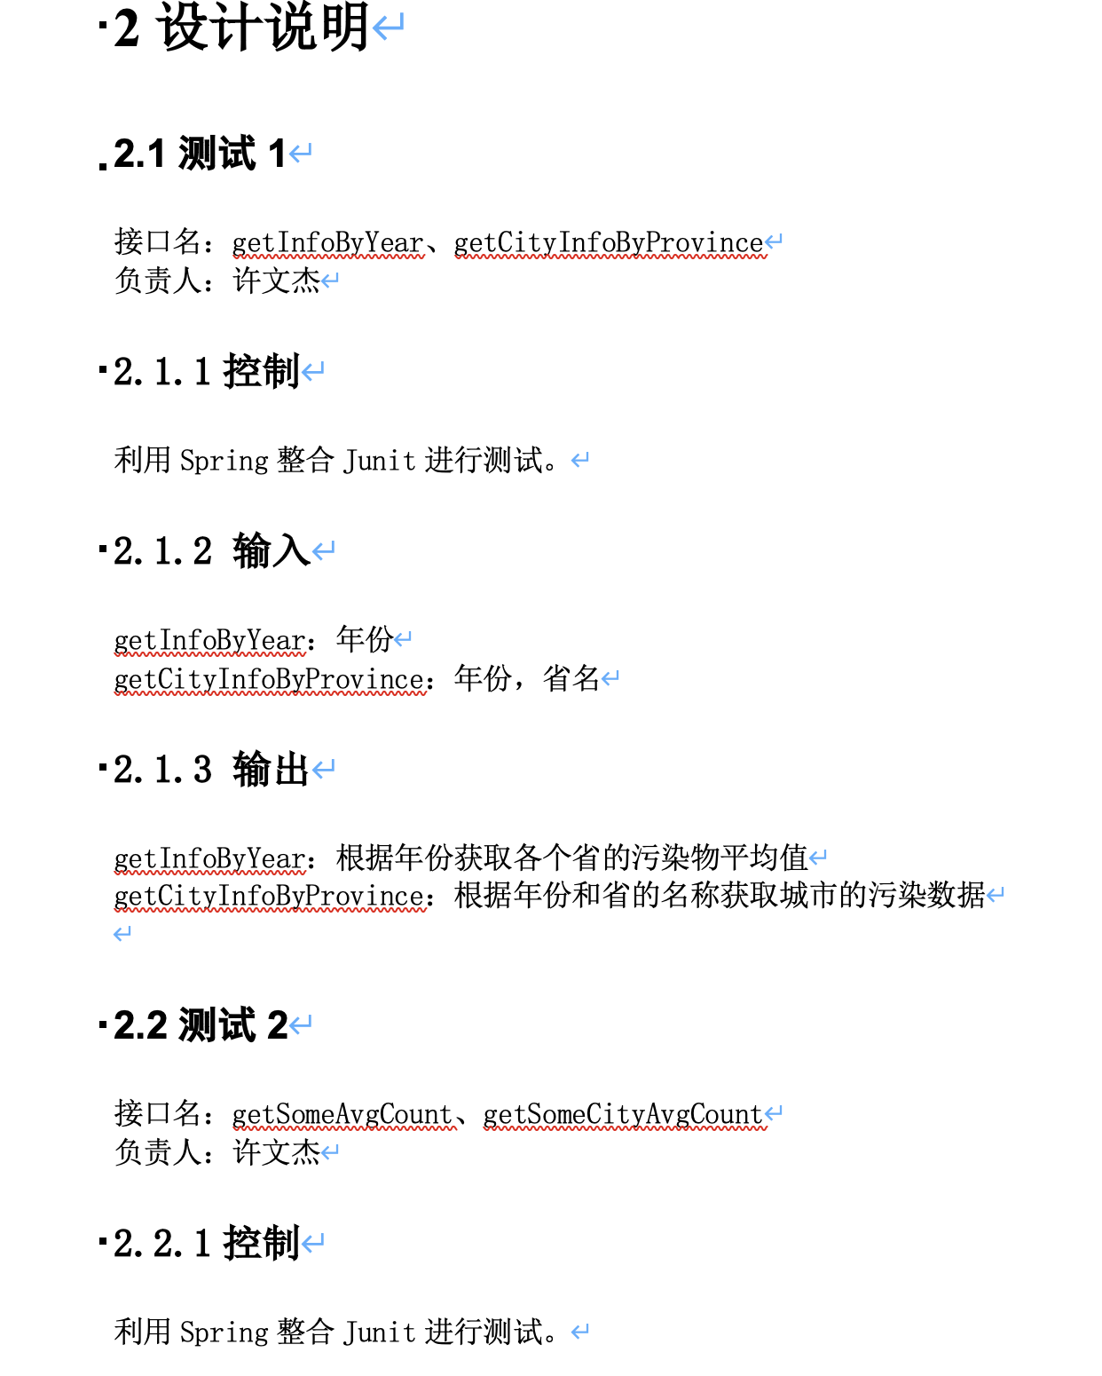
Test Plan
Design Notes
Control
Input
Output

Slide 18
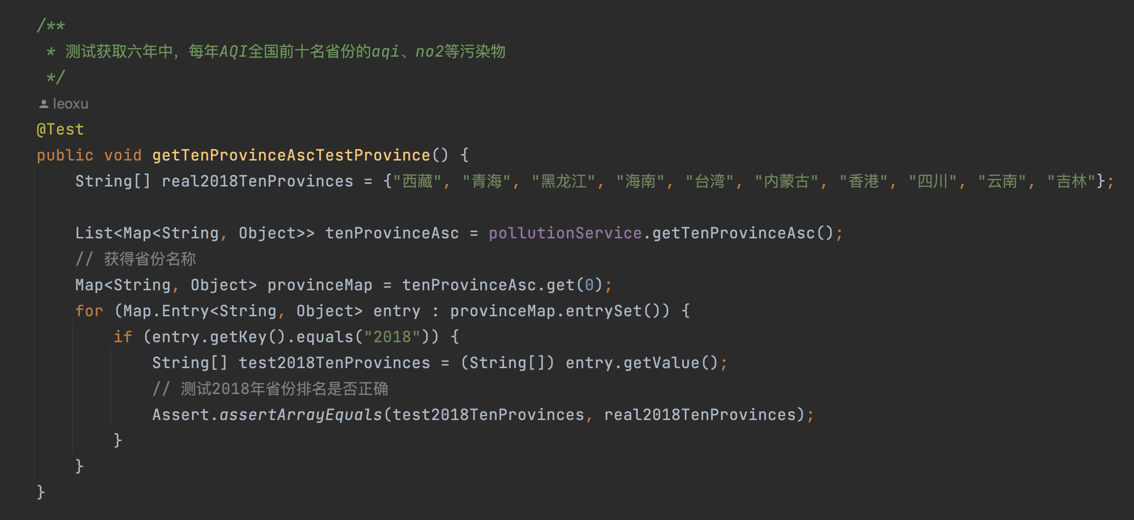
Test Cases
Legal input

Slide 19
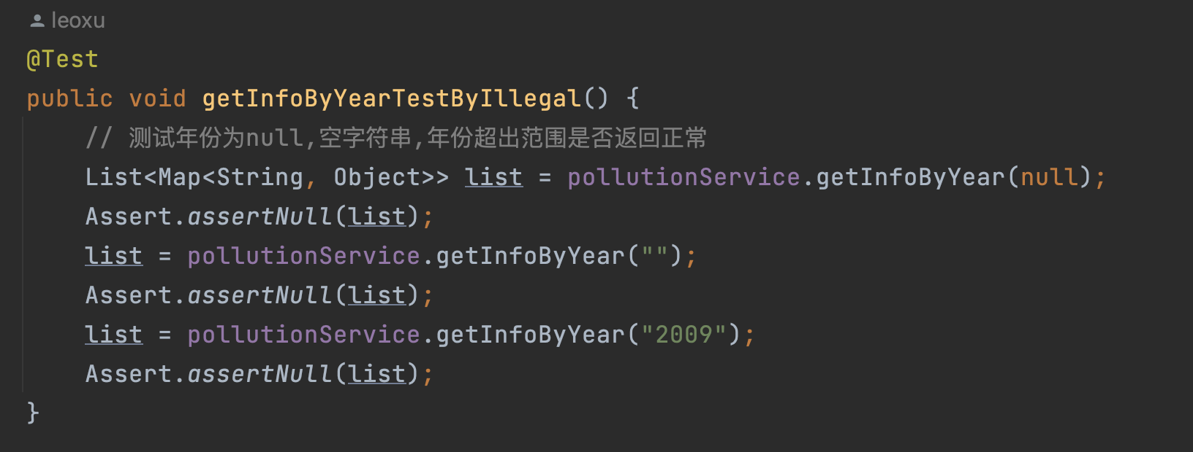
Test Cases
Illegal Input

Slide 20
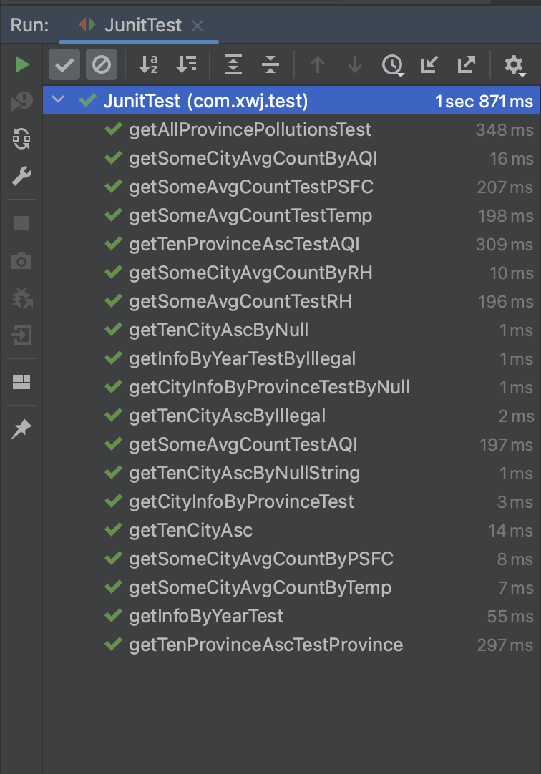
Test Cases
Test Results
A total of 19 test cases all passed the test with legal and illegal inputs.

Slide 21
Lessons Learnt
05

Slide 22
Lessons
Learnt
● Plan the project progress in advance, predict the risks and countermeasures comprehensively, and try best to perform the task according to the plan
● Pay attention to communication, effective communication can make the project go smoothly.
● Do a good job of backing up and maintaining the project.
● Understand the needs of users and market (job requirements) sufficiently.

Slide 23
06
Conclusion

Slide 24
Conclusion
●According to the project schedule, the visualization of pollutants in China and provinces between 2013 to 2018 was completed basically. Most of the risks we encountered with have been predicted in advance ,and all the risks have been resolved.
● The main manpower expenditure in the process of the project did not exceed the budget, and the planned functional points that need to completed were realized.
●The portion of data preprocessing took longer than expected because of large amount of data.

Slide 25
Future Plan
For Next Cycle
07

Slide 26
Future
Plan
● Perform multiple tests on the system and fix the current bugs
● In the future, we plan to do secondary cache optimization by using local cache and Redis to avoid database downtime and system breakdown due to a large number of requests in high concurrency scenarios
● Do cluster regions with the change trend of pollutants in each quarter, and acquire the Spatial-temporal distribution model of air pollution through comparative analysis of space and time.
● Add air pollution prediction function for each province and city in China

Slide 27
Thanks for watching

